Slide 1


Data Structures
ETCCBD201
Ms. Jyoti Yadav
Faculty
School of Engineering & Technology
K.R. Mangalam University
Unit 2 : Linear Data Structures

Slide 2

Unit-2 Linear Data Structures
SESSION 11 Arrays – 1D & 2D
SESSION 12 Static & Dynamic Arrays
SESSION 13 Linked Lists Types
SESSION 14 Linked List Operations
SESSION 15 Stack ADT & Operations
SESSION 16 Stack Applications
SESSION 17 Queue ADT
SESSION 18 Queue Applications
SESSION 19 BFS using Queue
SESSION 20 Revision (Unit–2)
Notes:
New Courses replaced with New Programmes

Slide 3
Stack ADT & Operations
Session 15
Introduction to Stack
Stack Definition & LIFO Principle
Real-World Analogies of Stack
Types of Stack (Fixed & Dynamic)
Stack Representation
Basic Stack Operations
Stack Overflow & Underflow Conditions
Algorithms for Stack Operations
Stack Implementation in Python/ C++
Working Examples & Practice Problems
Time Complexity of Stack Operations
Stack vs Array
Stack vs Linked List
Applications of Stack (Preview)
Summary & Key Takeaways
Quiz / Test Yourself
References
Notes:
New Courses replaced with New Programmes

Slide 4
Recapitulation (Linked List Operations)
Traversal visits each node starting from the head until NULL
Insertion can be done at the beginning, end, or after a given node
Deletion removes nodes from the beginning, end, or after a given node
Insertion/deletion at the beginning takes O(1) time
Operations at the end generally take O(n) time due to traversal
Notes:
New Courses replaced with New Programmes

Slide 5
Quick Quiz
Fill in the Blanks
Traversal of a linked list always starts from the __________ node.
Insertion at the beginning of a linked list has time complexity __________.
Deletion from the end of a singly linked list requires __________ of the list.
The last node of a singly linked list points to __________.
One-Word / Short Answer Questions
Fastest insertion operation in a linked list
Pointer used to move to the next node
Operation that removes the first node
Time complexity of insertion at end
Notes:
New Courses replaced with New Programmes

Slide 6
Quick Quiz (Answers)
Head
O(1)
Traversal
NULL
Insertion at beginning
Next
Deletion from beginning
O(n)
Notes:
New Courses replaced with New Programmes

Slide 7
Learning Objectives
After completing this lecture, students will be able to:
Define Stack as an Abstract Data Type (ADT)
Explain the LIFO (Last In First Out) principle
Identify different types of stacks
Describe stack operations: push, pop, peek, isEmpty, isFull
Detect stack overflow and underflow conditions
Write algorithms for stack operations
Implement stack using arrays and linked lists
Analyze time complexity of stack operations
Compare stack with array and linked list
Solve basic problems using stack
Notes:
New Courses replaced with New Programmes

Slide 8
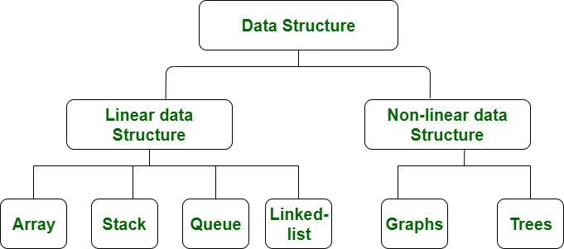
Data Structure Types
https://www.geeksforgeeks.org/data-structure-meaning/
Notes:
New Courses replaced with New Programmes

Slide 9

Background
Stack (n.)
The set of things a person has to do in the future, organized on a last-in, first-out (LIFO) basis.
“I haven’t done it yet because every time I pop my stack, something new gets pushed.”
If a person is interrupted several times in the middle of a conversation, saying “My stack overflowed” means “I forgot what we were talking about.”
— The Hacker’s Dictionary
Friedrich L. Bauer
German computer scientist who proposed “stack method of expression evaluation” in 1955.
Notes:
New Courses replaced with New Programmes

Slide 10

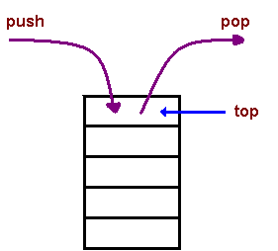
What is Stack?
A Stack is a linear data structure that holds a linear, ordered sequence of elements.
It is an abstract data type.
Follows LIFO (Last In First Out) or (FILO).
A stack is basically a container where items are inserted and removed from one end, called the top of the stack.
Limited Capacity
Real-world Analogy
Stack of plates
Undo/Redo operation
Browser history
https://dev.to/ogwurujohnson/demystifying-the-javascript-call-stack-1ppc
Notes:
New Courses replaced with New Programmes

Slide 11
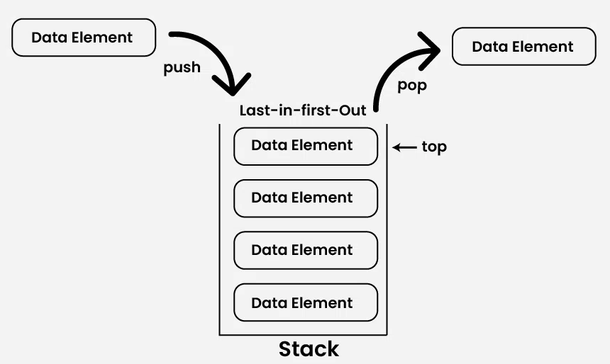
Stack?
https://www.geeksforgeeks.org/dsa/introduction-to-stack-data-structure-and-algorithm-tutorials/
Notes:
New Courses replaced with New Programmes

Slide 12
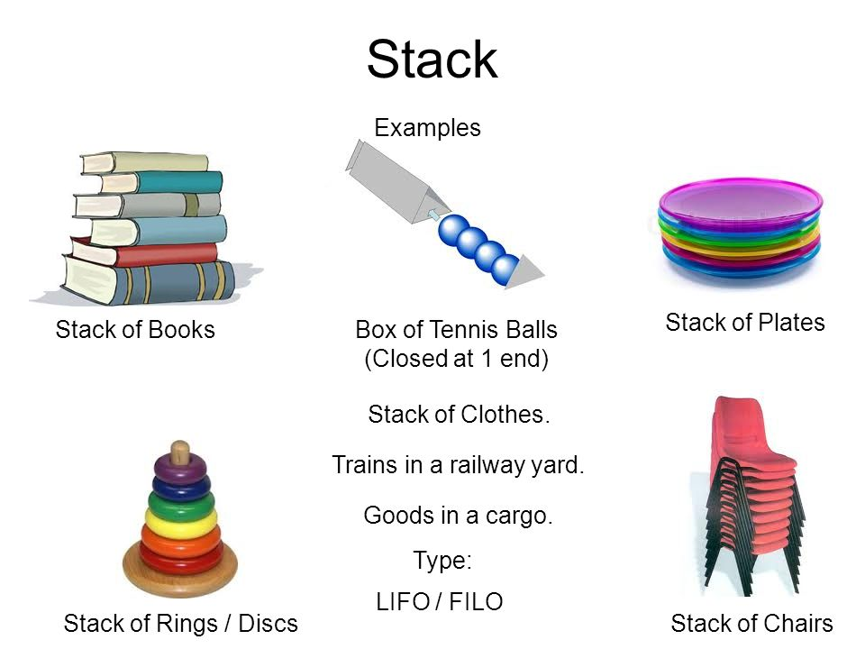
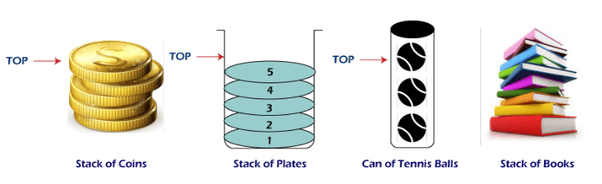
Stack Data Structure
Fig 1 : Stack Data Structure
https://www.javatpoint.com/applications-of-stack-in-data-structure
Notes:
New Courses replaced with New Programmes

Slide 13
Types of Stack
Fixed Size Stack :
Fixed size and cannot grow or shrink dynamically.
Dynamic Size Stack :
Can grow or shrink dynamically.
When the stack is full, it automatically increases its size to accommodate the new element, and when the stack is empty, it decreases its size.
This type of stack is implemented using a linked list, as it allows for easy resizing of the stack.
https://www.geeksforgeeks.org/dsa/introduction-to-stack-data-structure-and-algorithm-tutorials/
Notes:
New Courses replaced with New Programmes

Slide 14
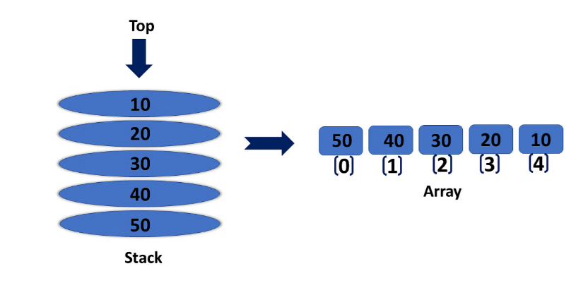
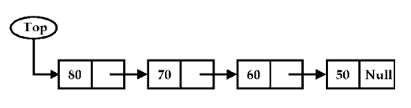
Representation of a stack
Array Representation of Stacks
Linked List Representation of Stacks
Notes:
New Courses replaced with New Programmes

Slide 15
Stack Operations
push() to insert an element into the stack
pop() to remove an element from the stack
peek() or top() returns the topmost element of the Stack without deleting it from the Stack.
Is Empty() returns true if stack is empty else false.
size() returns the size of stack.
Please Refer :
https://www.youtube.com/watch?v=HRDHgKrYHgU
Notes:
New Courses replaced with New Programmes

Slide 16
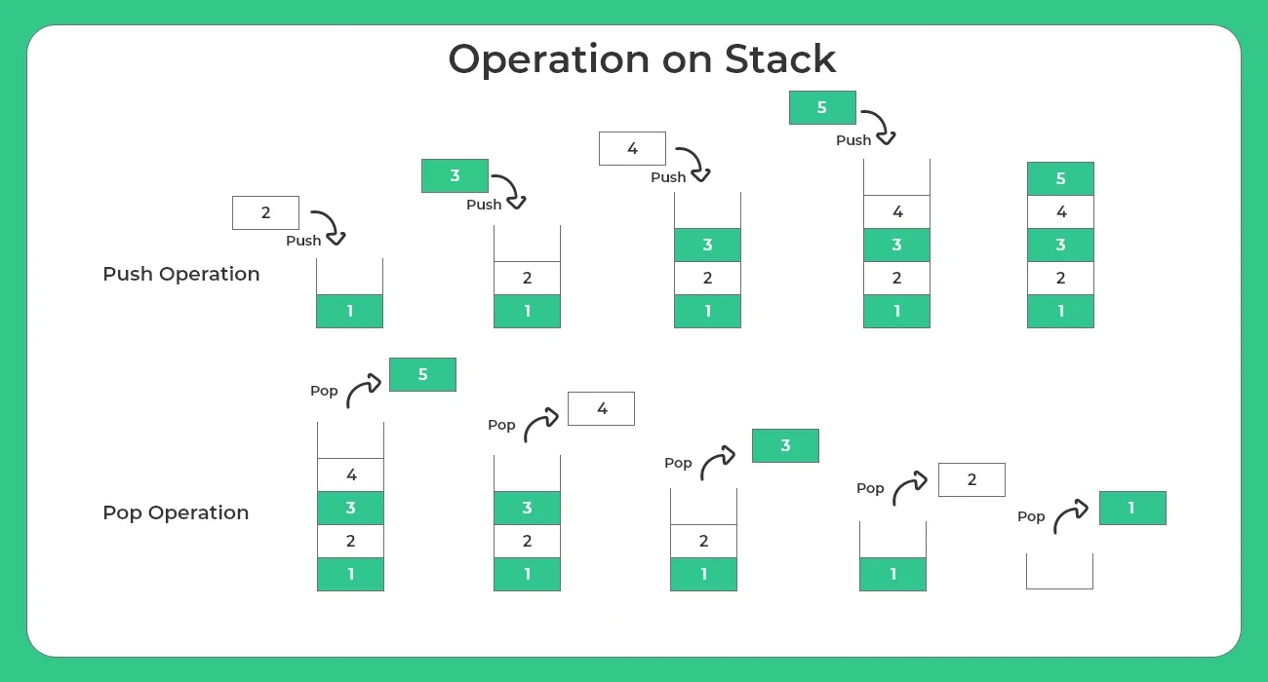
Stack Operations Push & Pop
https://prepinsta.com/data-structures/introduction-to-stacks-in-data-structures/
Notes:
New Courses replaced with New Programmes

Slide 17
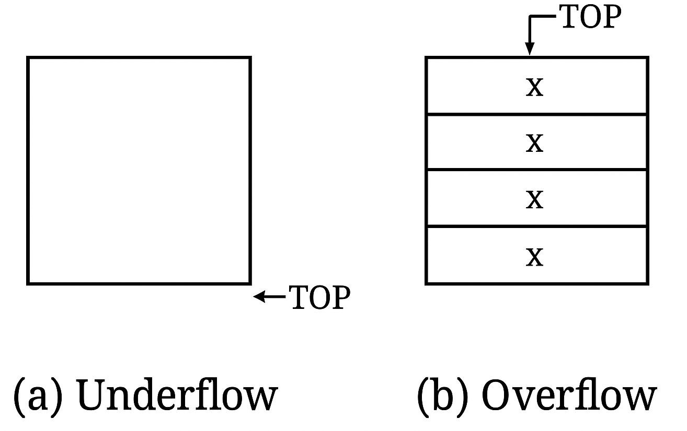
Conditions in Stack
Overflow
Underflow
https://www.geeksforgeeks.org/dsa/stack-data-structure/
Notes:
New Courses replaced with New Programmes

Slide 18
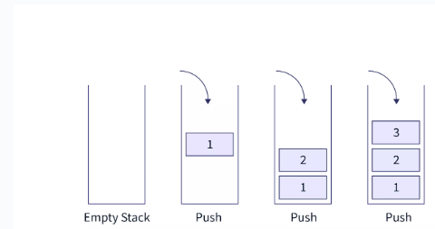
PUSH Operation
Algorithm:
Step-1: If TOP = Max-1
Print “Overflow”
Goto Step 4
Step-2: Set TOP= TOP + 1
Step-3: Set Stack[TOP]= ELEMENT
Step-4: END
Fig: Push operation
https://www.scaler.com/topics/stack-operations-in-data-structures/
Notes:
New Courses replaced with New Programmes

Slide 19
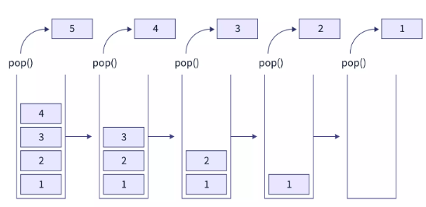
Pop Operations
Algorithm:
Step 1: START
Step 2: if top==-1
then Write “Stack is Underflow”
Step 3: otherwise
print “deleted element”
top=top-1;
Step 4: END
Notes:
New Courses replaced with New Programmes

Slide 20
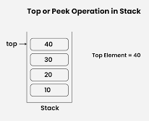
Top of Peek Operation
Algorithm:
Step-1: If TOP = NULL
PRINT “Stack is Empty”
Goto Step 3
Step-2: Return Stack[TOP]
Step-3: END
https://www.geeksforgeeks.org/dsa/introduction-to-stack-data-structure-and-algorithm-tutorials/
Notes:
New Courses replaced with New Programmes

Slide 21
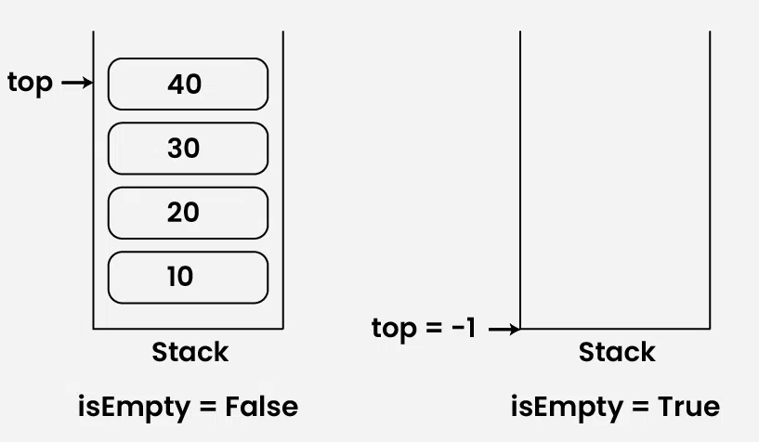
isEmpty Operation
Algorithm:
Check for the value of top in stack.
If (top == -1), then the stack is empty so return true .
Otherwise, the stack is not empty so return false .
https://www.geeksforgeeks.org/dsa/introduction-to-stack-data-structure-and-algorithm-tutorials/
Notes:
New Courses replaced with New Programmes

Slide 22
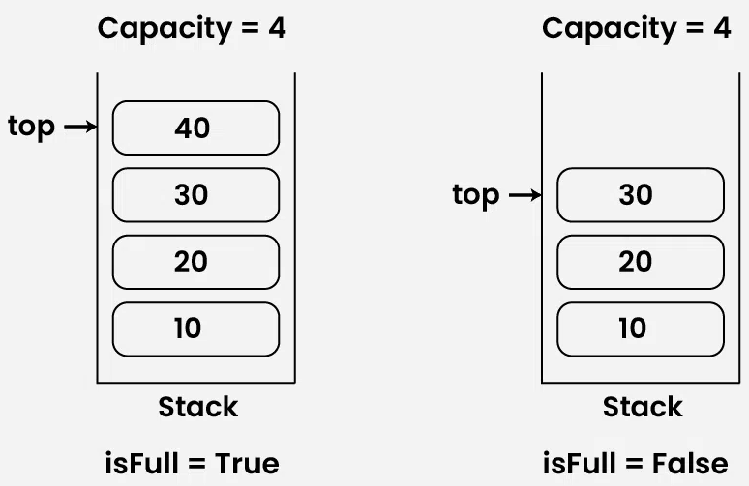
isFull Operation
Algorithm:
Check for the value of top in stack.
If (top == capacity-1), then the stack is full so return true.
Otherwise, the stack is not full so return false.
https://www.geeksforgeeks.org/dsa/introduction-to-stack-data-structure-and-algorithm-tutorials/
Notes:
New Courses replaced with New Programmes

Slide 23
Check for Understanding
❓ What happens when we push into a full stack?
❓ Which end of the stack is used for insertion?
❓ What does pop() return?
Notes:
New Courses replaced with New Programmes

Slide 24
Check for Understanding (Answers)
❓ What happens when we push into a full stack? A stack overflow condition occurs.
❓ Which end of the stack is used for insertion? The top (TOP) end of the stack.
❓ What does pop() return? It returns (and removes) the top element of the stack.
Notes:
New Courses replaced with New Programmes

Slide 25
Code for push & pop operation in Python
stack = []
# Push operation
def push(val):
stack.append(val)
print(val, "pushed into stack")
# Pop operation
def pop():
if len(stack) == 0:
print("Stack Underflow")
else:
popped = stack.pop()
print("Popped element:", popped)
# Example usage
push(10)
push(20)
push(30)
pop()
pop()
print("Final Stack:", stack)
OUTPUT:
10 pushed into stack
20 pushed into stack
30 pushed into stack
Popped element: 30
Popped element: 20
Final Stack: [10]
Notes:
New Courses replaced with New Programmes

Slide 26
Code for push & pop operation in C++
void newstack(stack <int> ss)
{
stack <int> sg = ss;
while (!sg.empty())
{
cout << '\t' << sg.top();
sg.pop();
}
cout << '\n';
}
Complete code here
Notes:
New Courses replaced with New Programmes

Slide 27
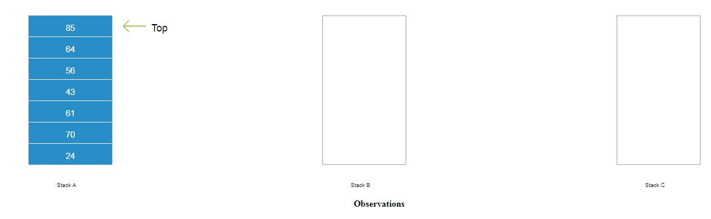
Working of stack
Observe: Stack A with random numbers is given. Observe how the prime numbers from stack A are popped and pushed into stack B whereas the others are pushed into stack C.
Notes:
New Courses replaced with New Programmes

Slide 28
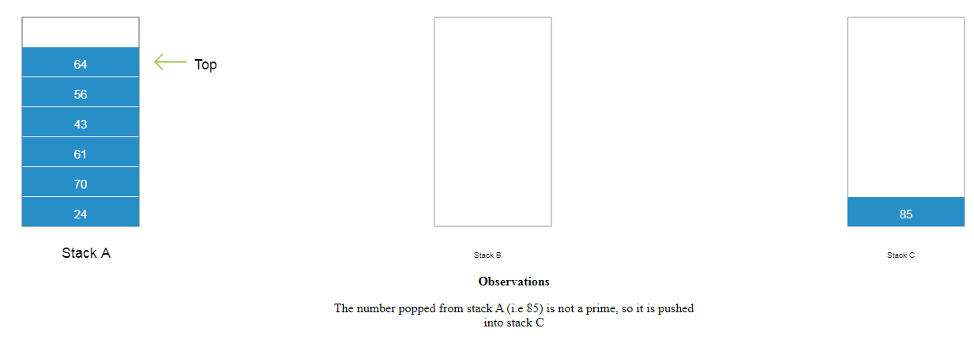
Working of stack
Notes:
New Courses replaced with New Programmes

Slide 29
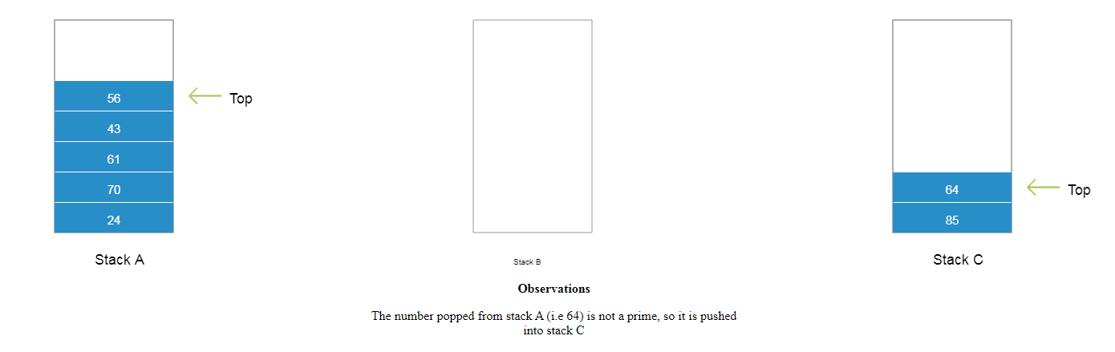
Working of stack
Notes:
New Courses replaced with New Programmes

Slide 30
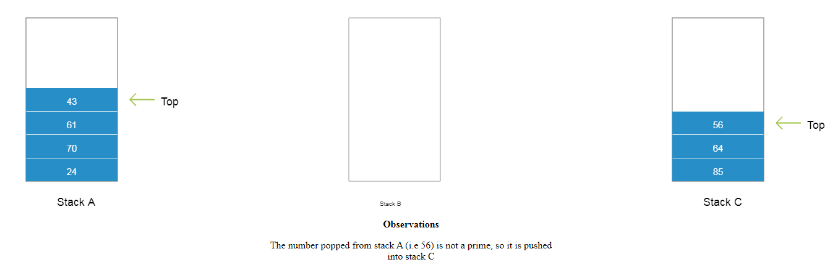
Working of stack
Notes:
New Courses replaced with New Programmes

Slide 31
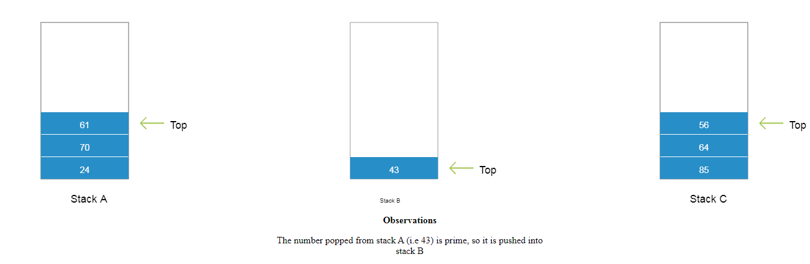
Working of stack
Notes:
New Courses replaced with New Programmes

Slide 32
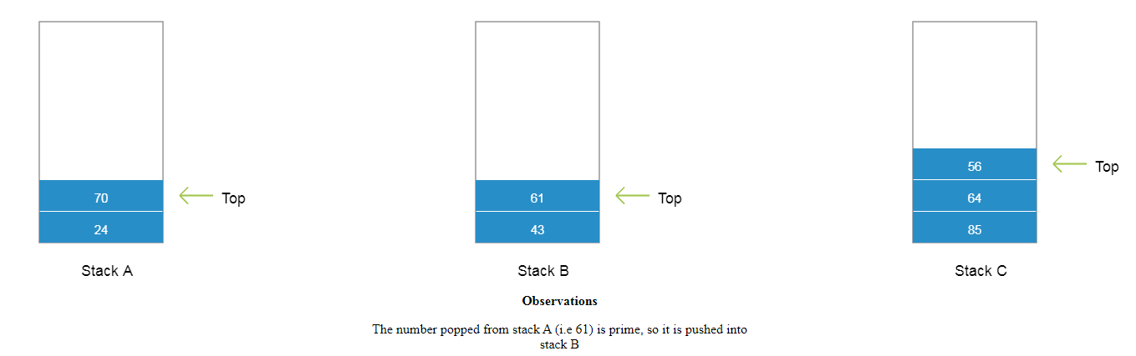
Working of stack
Notes:
New Courses replaced with New Programmes

Slide 33
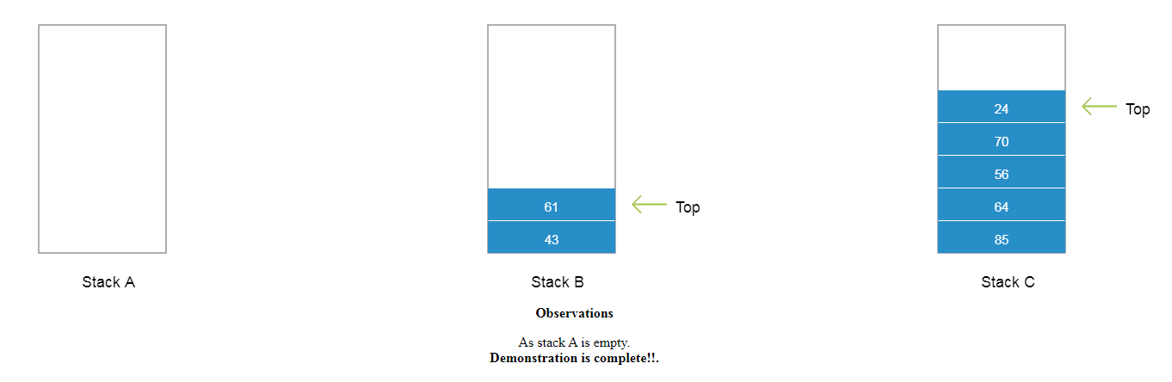
Working of stack
Notes:
New Courses replaced with New Programmes

Slide 34
Practice Question
Example:
Push 10, 20, 30 into an empty stack
Pop one element
Show:
Step-by-step stack content
TOP movement
Notes:
New Courses replaced with New Programmes

Slide 35
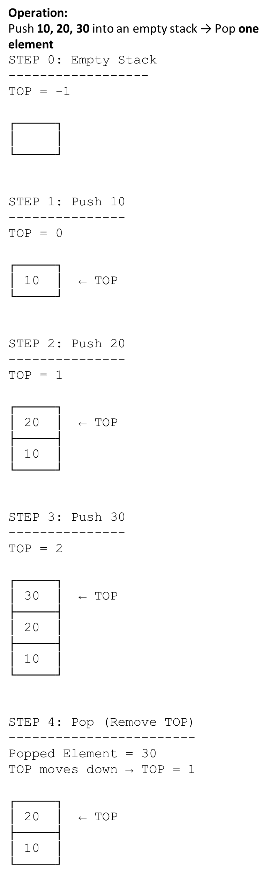
Practice Question (Solution)
Push 10, 20, 30 into an empty stack->Pop one element
Notes:
New Courses replaced with New Programmes

Slide 36
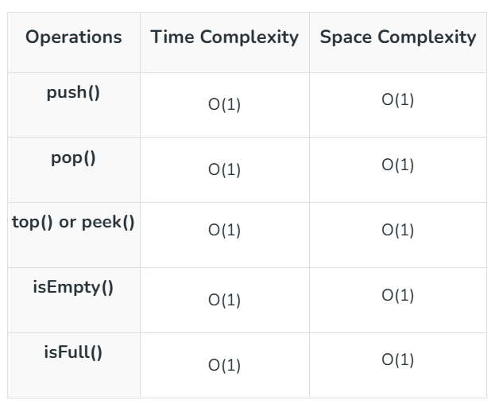
Complexity Analysis of Operations on Stack Data Structure
Notes:
New Courses replaced with New Programmes

Slide 37
Test Your self
1. Which among the following represents a stack?
a: People waiting at a counter, where the action of popping is when someone has been served at the counter
b: A hand of bangles where pushing is wearing a new bangle
c: A pile of plates at a dinner party
d: People going around a merry-go-round
Notes:
New Courses replaced with New Programmes

Slide 38
Test Your self
2. What is the time complexity of push operation in a stack? What is the time complexity of pop operation in a stack?
a: O(n), O(n)
b: O(1), O(n)
c: O(n), O(1)
d: O(1), O(1)
Notes:
New Courses replaced with New Programmes

Slide 39
Test Your self
3. Consider these operations on an empty stack: push(3), push(5), pop(), push(10), push(11), pop(), push(100). What will be the stack configuration (first number is top of the stack, last is the bottom)
a: 100,10,3
b: 3,5,10,11,100
c: 3,10,100
d: None of the above
Notes:
New Courses replaced with New Programmes

Slide 40
Test Your self
4. Consider a stack initially empty. Perform the following operations:
a) Push 5, Push 10, Push 15
b) Pop an element
c) Push 20
What is the final state of the stack?
Notes:
New Courses replaced with New Programmes

Slide 41
Test Your self
Answers:
Correct Option: C
Correct Option: D
Correct Option: A
TOP → 20, Stack Elements (Top to Bottom): 20, 10, 5
Notes:
New Courses replaced with New Programmes

Slide 42
Stack vs Array
Feature | Stack | Array
Nature | Abstract Data Type (ADT) | Linear data structure
Access | Restricted (LIFO – only top element) | Random access using index
Insertion/Deletion | Only at one end (TOP) | At any position
Principle | Last In First Out (LIFO) | No specific order
Operations | push, pop, peek | insert, delete, update, access
Use case | Function calls, undo/redo, expression evaluation | Storing and accessing data by index
Flexibility | Limited operations | More flexible operations
A stack is a specialized structure with restricted access, while an array allows direct access to any element.
Notes:
New Courses replaced with New Programmes

Slide 43
Stack vs Linked List
Feature | Stack | Linked List
Type | Abstract Data Type (ADT) | Linear data structure
Access | Only top element | Any node (via traversal)
Insertion/Deletion | Only at top | At beginning, end, or any position
Memory | Can be array-based or linked-list-based | Uses dynamic memory (nodes + pointers)
Order | LIFO | No fixed order
Implementation | Can use array or linked list | Uses nodes with pointers
Flexibility | Less flexible | More flexible
A stack restricts how data is accessed, while a linked list allows flexible insertion and deletion anywhere.
Notes:
New Courses replaced with New Programmes

Slide 44
Quick Quiz
Which principle does Stack follow?
Which operation removes the top element?
What is stack underflow?
What is stack overflow?
Notes:
New Courses replaced with New Programmes

Slide 45
Quick Quiz (Answers)
Which principle does Stack follow?
LIFO (Last In, First Out)
Which operation removes the top element?
Pop
What is stack underflow?
Stack underflow occurs when an attempt is made to pop an element from an empty stack.
What is stack overflow?
Stack overflow occurs when an attempt is made to push an element into a full stack.
Notes:
New Courses replaced with New Programmes

Slide 46
Stack Implementation
Stack can be implemented using:
Arrays
Linked List
Notes:
New Courses replaced with New Programmes

Slide 47
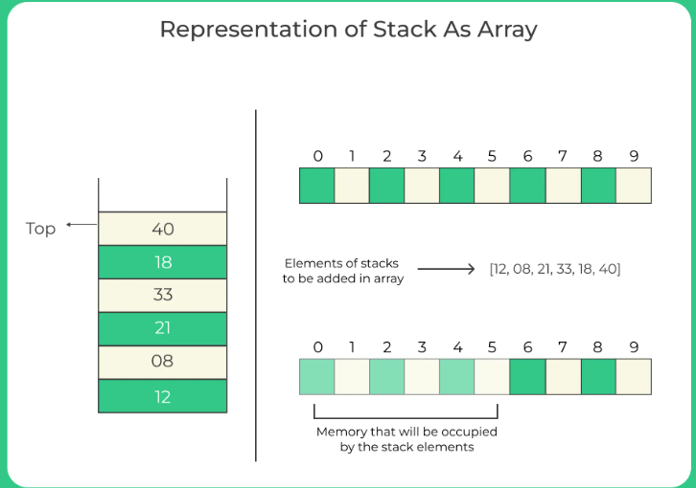
Array representation of Stack
Fig: Array Representations
https://prepinsta.com/data-structures/representation-of-a-stack/
Notes:
New Courses replaced with New Programmes

Slide 48
Why Implement Stack Using Array?
Simple and Direct Access
Indexing
Time Complexity
Predictable Memory Usage
Fixed Size
Memory Allocation
Ease of Implementation
Simplicity
Less Overhead
Performance
Efficient Operations
No Pointer Management
Notes:
New Courses replaced with New Programmes

Slide 49
Limitations of Stack Implementation Using Array
Fixed Size
Wasted Space
Resizing Issues
Notes:
New Courses replaced with New Programmes

Slide 50
Stack Implementation using array in Python
A program to implement a stack using an array that performs the following operations:
Push an element into the stack (with stack overflow condition).
Pop an element from the stack (with stack underflow condition).
Display all elements of the stack from top to bottom.
The program is menu-driven, allowing the user to choose an operation repeatedly until the exit option is selected.
def pop():
global top
if top <= -1:
print("Stack Underflow")
else:
print("The popped element is", stack[top])
top -= 1
def display():
if top >= 0:
print("Stack elements are:")
for i in range(top, -1, -1):
print(stack[i], end=" ")
print()
else:
print("Stack is empty")
# Stack implementation using array
stack = [0] * 100
n = 100
top = -1
def push(val):
global top
if top >= n - 1:
print("Stack Overflow")
else:
top += 1
stack[top] = val
Notes:
New Courses replaced with New Programmes

Slide 51
Contd.
def main():
while True:
print("\n1) Push in stack")
print("2) Pop from stack")
print("3) Display stack")
print("4) Exit")
ch = int(input("Enter choice: "))
if ch == 1:
val = int(input("Enter value to be pushed: "))
push(val)
elif ch == 2:
pop()
elif ch == 3:
display()
elif ch == 4:
print("Exit")
break
else:
print("Invalid Choice")
if __name__ == "__main__":
main()
Notes:
New Courses replaced with New Programmes

Slide 52
Stack Implementation using array in C++
#include <iostream.h>
using namespace std;
int stack[100], n=100, top=-1;
void push(int val) {
if(top>=n-1)
cout<<"Stack Overflow"<<endl;
else {
top++;
stack[top]=val;
}
}
void pop()
{
if(top<=-1)
cout<<"StackUnderflow"<<endl;
else
{ cout<<"The popped element is "<< stack[top] <<endl;
top--; }
}
void display() {
if(top>=0) {
cout<<"Stack elements are:";
for(int i=top; i>=0; i--)
cout<<stack[i]<<" ";
cout<<endl;
} else
cout<<"Stack is empty";
}
int main() {
int ch, val;
cout<<"1) Push in stack"<<endl;
cout<<"2) Pop from stack"<<endl;
cout<<"3) Display stack"<<endl;
cout<<"4) Exit"<<endl;
do {
cout<<"Enter choice: "<<endl;
cin>>ch;
Notes:
New Courses replaced with New Programmes

Slide 53
Conti..
switch(ch) {
case 1:
{
cout<<"Enter value to be pushed:"<<endl;
cin>>val;
push(val);
break;
}
case 2: {
pop();
break;
}
}
}
while(ch!=4);
return 0;
}
case 3: {
display();
break;
}
case 4: {
cout<<"Exit"<<endl;
break;
}
default:
{
cout<<"Invalid Choice"<<endl;
}
Notes:
New Courses replaced with New Programmes

Slide 54
Test Your self
Let S be a stack of size n >= 1. Starting with the empty stack, suppose we push the first n natural numbers in sequence, and then perform n pop operations. Assume that Push and Pop operation take X seconds each, and Y seconds elapse between the end of one such stack operation and the start of the next operation.
For m >= 1, define the stack-life of m as the time elapsed from the end of Push(m) to the start of the pop operation that removes m from S.
The average stack-life of an element of this stack is
n(X+ Y)
3Y + 2X
n(X + Y)-X
Y + 2X
Notes:
New Courses replaced with New Programmes

Slide 55
Test Your self
Solution:
Let's n = 3
1 ( Pushed in Stack ) : Time take = X 2 ( Pushed in Stack ) : Time take = X 3 ( Pushed in Stack ) : Time take = X 3 ( Popped Out of Stack ) : Time take = X 2 ( Popped Out of Stack ) : Time take = X 1 ( Popped Out of Stack ) : Time take = X
Stack Life of 3 = y Stack Life of 2 = 3(x + y ) - x Stack Life of 1 = 5(x + y ) - x
Average Stack Life of Element = ( Y + (3(X + Y ) - X ) + (5(X + Y ) - X) ) /3 = ( 6X + 9Y )/3 = 2X + 3Y
For n= 3 the average stack life is 2X +3Y Similarly for n elements, the average stack life will be n( X + Y ) -X
Notes:
New Courses replaced with New Programmes

Slide 56
Test Your self
2. A single array A[1..MAXSIZE] is used to implement two stacks. The two stacks grow from opposite ends of the array. Variables top1 and top2 (topl< top 2) point to the location of the topmost element in each of the stacks. If the space is to be used efficiently, the condition for “stack full” is:
(top1 = MAXSIZE/2) and (top2 = MAXSIZE/2+1)
top1 + top2 + 1 = MAXSIZE
(top1= MAXSIZE/2) or (top2 = MAXSIZE)
top1= top2 -1
Notes:
New Courses replaced with New Programmes

Slide 57
Test Your self
3. Which of the following permutation can be obtained in the same order using a stack assuming that input is the sequence 5, 6, 7, 8, 9 in that order?
7, 8, 9, 5, 6
5, 9, 6, 7, 8
7, 8, 9, 6, 5
9, 8, 7, 5, 6
Notes:
New Courses replaced with New Programmes

Slide 58
Test Your self
Answers:
Correct Option: C
Correct Option : D
Correct Option : C
Notes:
New Courses replaced with New Programmes

Slide 59
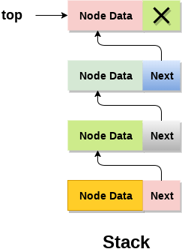
Implementation of Stack using Linked List
In the Linked List implementation of a stack, the nodes are maintained non-contiguously in memory.
Each node contains a pointer to its immediate successor node in the stack.
Stack is said to be overflown if the space left in the memory heap is not enough to create a node.
Notes:
New Courses replaced with New Programmes

Slide 60
Adding a node to the stack (Push operation)
Step 1: Allocate memory for the new node and name it as NEW_NODE
Step 2: SET NEW_NODE-> DATA=VAL
Step 3: IF TOP=NULL
SET NEW_NODE->NEXT=NULL
SET TOP=NEW_NODE
ELSE
SET NEW_NODE->NEXT=TOP
SET TOP=NEW_NODE
[END OF IF]
Step 4: END
Notes:
New Courses replaced with New Programmes

Slide 61
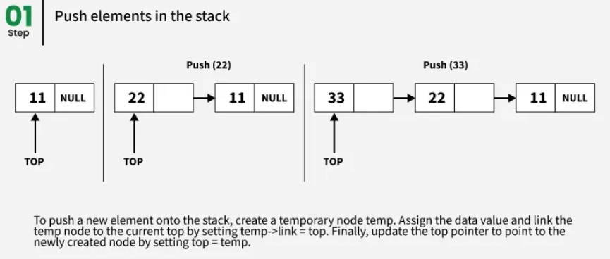
Adding a node to the stack (Push operation)
Notes:
New Courses replaced with New Programmes

Slide 62
Deleting a node from the stack (POP operation)
Step 1: IF TOP=NULL
PRINT "UNDERFLOW"
Goto Step 5
[END OF IF]
Step 2: SET PTR=TOP
Step 3: SET TOP=TOP->NEXT
Step 4: FREE PTR
Step 5: END
Notes:
New Courses replaced with New Programmes

Slide 63
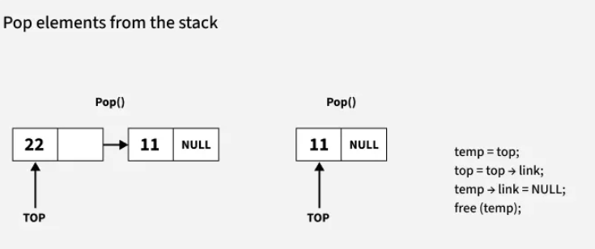
Deleting a node from the stack (POP operation)
Notes:
New Courses replaced with New Programmes

Slide 64
Key Takeaways
Stack is a linear data structure based on the LIFO principle.
All insertions and deletions happen only at the TOP.
Main operations are push, pop, peek, isEmpty, and isFull.
Stack can be implemented using arrays or linked lists.
Push and pop operations take O(1) time in most cases.
Overflow occurs when stack is full; underflow occurs when stack is empty.
Array implementation is simple but has fixed size limitations.
Linked list implementation allows dynamic size but uses extra memory for pointers.
Stack is widely used in expression evaluation, recursion, undo/redo, parsing, and memory management.
Notes:
New Courses replaced with New Programmes

Slide 65
References
Textbooks
Cormen, T. H., Leiserson, C. E., Rivest, R. L., & Stein, C., Introduction to Algorithms, MIT Press.
Lipschutz, S., Schaum’s Outline of Data Structures with C++, McGraw-Hill Education.
Reference Books
Weiss, M. A., Data Structures and Algorithm Analysis in C++, 5th Edition, Pearson Education.
Skiena, S. S., The Algorithm Design Manual, 3rd Edition, Springer.
Online Resources
GeeksforGeeks – Stack Introduction https://www.geeksforgeeks.org/stack-data-structure/
PrepInsta – Stack Operations https://prepinsta.com/data-structures/introduction-to-stacks-in-data-structures/
Scaler – Stack Operations Algorithms https://www.scaler.com/topics/stack-operations-in-data-structures/
JavaTpoint – Applications of Stack https://www.javatpoint.com/applications-of-stack-in-data-structure
Programiz – Stack in Python https://www.programiz.com/dsa/stack
Notes:
New Courses replaced with New Programmes

Slide 66
THANK YOU

